Slide 1
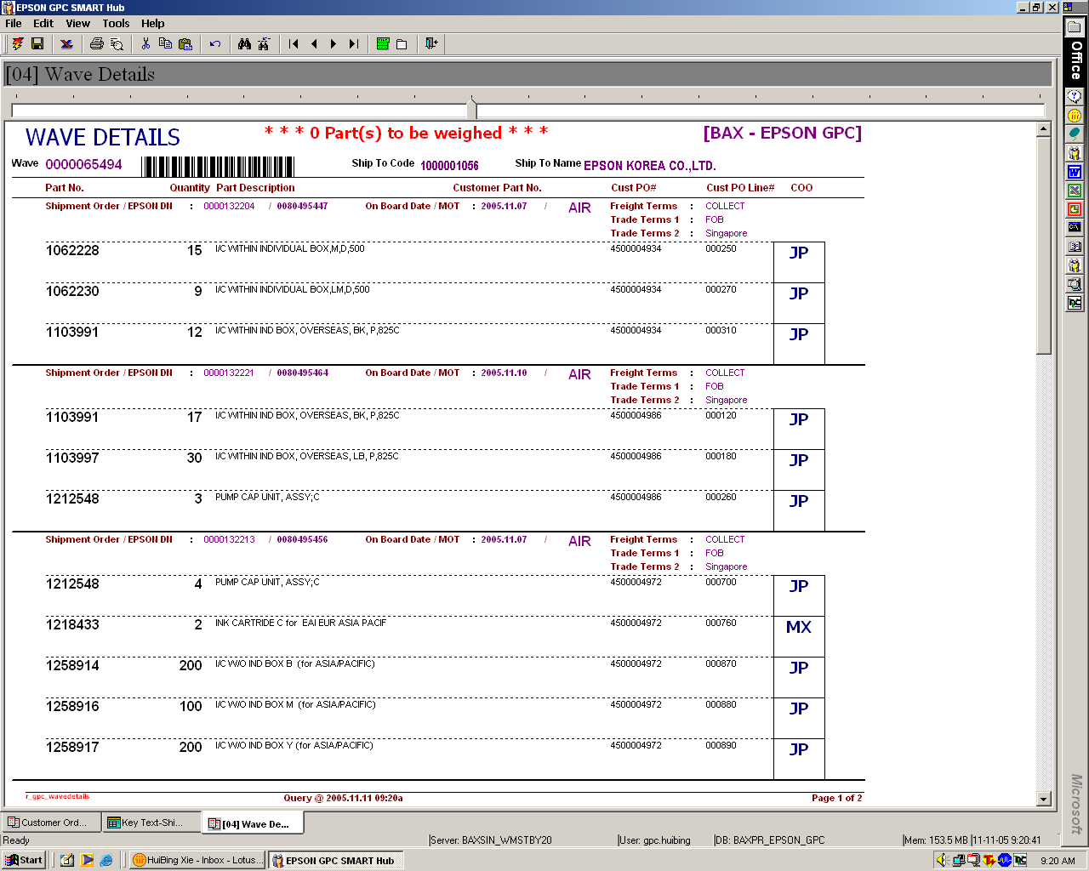
To flag “Type of Pallets to be used”
(Tie to Ship To Code)
Plastic
Heat Treated
Non-Coniferous
Recycled/New

